Slide 1
UNLOCKING SECURITY: ENHANCED SIGNATURE VERIFICATION SYSTEM USING IMAGE PROCESING
BY:
KARTHIKEYAN P(310120104040)
MURALIDHARAN U(310120104055)
CSE,AIHT
PROJECT GUIDE:
MRS.R.PRATHEEBA
(AP/CSE),AIHT

Slide 2
Introduction :
Signatures serve as a fundamental method of authentication, validating the identity of individuals and confirming their consent or approval on various documents.
However, traditional methods of manual signature verification are labor-intensive, time- consuming, and susceptible to errors. As a result, there is a growing need for automated systems that can verify signatures, leveraging the capabilities of image processing technology.
Manual signature verification typically involves visual inspection by trained professionals, who compare a submitted signature with reference samples to determine its authenticity.
However, this process is subject to several limitations:
Subjectivity, Time-Consuming, Expertise Required.
Image processing techniques offer a promising solution. By analyzing the signatures, these techniques can extract and quantify various visual features, enabling automated comparison and authentication processes.
Components of Signature Verification Using Image Processing:
Image Acquisition, Preprocessing, Feature Extraction and Representation, Comparison Algorithm (SSIM).

Slide 3
Abstract :
This signature verification system utilizing image processing techniques, with a focus on the Structural Similarity Index (SSIM) algorithm. The system aims to authenticate signatures by comparing a reference signature with a query signature.
Through the integration of image processing methodologies, the system extracts relevant features from the signatures to facilitate comparison and authentication. The SSIM algorithm serves as a key component in quantifying the structural similarity between signatures, enabling robust and accurate verification.
The Structural Similarity Index (SSIM) algorithm assesses the likeness between two images by comparing their structural information, luminance, and contrast.
It dissects images into patches, computing local statistics such as mean, variance, and covariance for each.
These statistics facilitate the computation of individual SSIM values for patch pairs, which are then aggregated to produce an overall SSIM value for the entire image.
Higher SSIM values indicate greater perceptual similarity between the images. SSIM's ability to capture structural details makes it suitable for tasks like image quality assessment.

Slide 4
Literature Survey:
Title | Authors | Publisher | Year | Concept Discussed | Methodology | Knowledge Gained | Disadvantage
New Textural Features Handwritten Signature Image Verification | Suriya Soisang, Suvit Poomrittigul | IEEE | 2024 | A new textural feature, Local Binary Gradient Quantization Angle Patterns (LBGQAP), for offline handwritten signature verification. The concept integrates Local Binary Patterns (LBP) with Gradient Quantization Angle (GQA) to enhance the precision of signature verification. | Develop the LBGQAP method by combining LBP with GQA and utilize an Artificial Neural Network (ANN) classifier for signature verification. | It demonstrating the effectiveness of LBGQAP compared to traditional methods. The study highlights the importance of feature extraction techniques in enhancing the accuracy of signature verification systems. | While the proposed LBGQAP method shows promising results, further research could investigate its performance across diverse datasets and evaluate its robustness against various types of forgeries and exploring the scalability and real-world applicability of the method could provide valuable insights for its implementation in practical settings.
Signature Recognition Using Image Processing | Mirudu Basini K S, Gopinath R | IJARIIE | 2022 | The development of a Scale Invariant Feature Transform (SIFT) based Automatic Signature Recognition (ASR) system for identifying particularly for traffic control purposes. | The method for efficient license plate localization in images with complex backgrounds, utilizing techniques such as image enhancement, edge extraction, and morphological filtering. It also discusses character segmentation and recognition using OCR methods. | The application of image processing techniques for signature recognition and character analysis, along with discussing the challenges and approaches in this domain. | While the paper presents a method for signature recognition, it does not extensively discuss the evaluation of the proposed system's performance or compare it with existing methods in the literature.

Slide 5
Title | Authors | Publisher | Year | Concept Discussed | Methodology | Knowledge Gained | Disadvantage
Signature Verification Using Image Processing Techniques | Amina Khatra | GRA - GLOBAL RESEARCH ANALYSIS | 2022 | Offline signature verification using image processing techniques. The use of Image processing Components such as Pre-processing, feature extraction and validation was used in this system. | Proposing a method for offline verification of signatures using simple shape- based geometric features, preprocessing of scanned images, feature extraction, and comparison with a template signature. | Importance of offline signature verification, challenges in feature extraction, classification, and achieving high accuracy across different signature styles. | Storing of the signature in the database as well as local device and the uses the basic image processing.
Offline Signature Verification Using Image Processing | Bushra Shaik, Jyothi Manohar Katikireddy, Vamsidhar Kambham, K Sravani | E3S Web of Conferences | 2023 | Offline signature verification using Convolutional Neural Networks (CNN), image processing techniques, deep learning, and recurrent neural networks (RNNs). | offline signature verification using CNNs, focusing on feature extraction and classification. They trained various CNN architectures such as VGG16, Inception, ResNet50, and Xception using different optimizers to achieve high accuracy in signature recognition. | Understanding of how CNNs and other deep learning techniques can be applied to offline signature verification, the importance of feature extraction, model training, and evaluation for achieving accurate results. | Using of data training may the forger can insert his/her signature in the dataset.

Slide 6
Title | Authors | Publisher | Year | Concept Discussed | Methodology | Knowledge Gained | Disadvantage
Signature Verification using Image Processing & Neural Network | Sayali Gowre | International Journal of Advanced Research in Science, Communication and Technology (IJARSCT) | 2022 | Offline signature verification using image processing techniques and neural networks. Various image processing techniques such as grayscale conversion, median filtering, intensity adjustment, thresholding, and canny edge detection were employed to preprocess the signature images. The processed images were then fed into a neural network for classification | Various image processing techniques such as grayscale conversion, median filtering, intensity adjustment, thresholding, and canny edge detection were employed to preprocess the signature images. The processed images were then fed into a neural network for classification | The study explored techniques for preprocessing signature images, feature extraction, and classification using neural networks. | Additionally, exploring the integration of online and offline verification methods could enhance the overall performance of signature verification systems and Using of data training may the forger can insert his/her signature in the dataset.

Slide 7
Scope:
The scope of this project encompasses several key aspects of signature verification using image processing techniques:
Document Authentication: Implement the system to verify signatures on important documents such as contracts, legal agreements, and financial transactions to ensure their authenticity.
Banking and Finance: Integrate the system into banking applications for verifying signatures on checks, loan documents, and other financial instruments to prevent fraud and unauthorized transactions.
Forensic Analysis: Apply the system in forensic investigations and criminal cases for verifying signatures on evidence, crime scene documents, and witness statements to support legal proceedings.
Education: Implement the system in educational institutions for verifying signatures on exam papers, certificates, and academic transcripts to prevent cheating and ensure academic integrity.

Slide 8
Objective:
The primary objective of this project is to design and implement an automated system capable of verifying signatures by analyzing their visual characteristics.
Feature Extraction: To extract relevant features from signature images, such as stroke patterns, curvature, texture, and spatial relationships between key points, pressure.
Comparison and Matching: Design methodologies for comparing and matching the extracted features of an input signature with those of a reference signature and matching by using SSIM Algorithm.
Implementation: Implement the signature verification system using image processing libraries and frameworks.
Evaluation: Evaluate the performance of the developed system through extensive testing on genuine and forged signatures. Measure key performance metrics such as accuracy, precision, recall.

Slide 9
Existing System:
The Existing signature verification systems predominantly rely on manual inspection or basic rule-based algorithms.
Manual verification methods involve visual inspection of signatures by trained personnel, which can be subjective and time- consuming.
Rule-based algorithms often use simple metrics such as geometric features for verification, but these methods may lack robustness and are susceptible to forgery. Moreover, existing systems may not fully exploit the potential of advanced machine learning algorithms.
The integration of sophisticated models like CNN and ANN is projected to the train of the data in which roots to the forgery.

Slide 10
Disadvantage:
Variability:
Signatures can differ significantly each time they are written, leading to the inconsistencies in verification accuracy of the system.
Forgery on Training data:
With only a dataset for training. When a forgery adds their signature in the dataset, the system will accurately identify signatures, especially those from individuals not included in the training set.
Privacy Concerns:
Collecting and storing handwritten signature data raises privacy concerns, particularly regarding the security of sensitive personal information which is stored in the database.
Legal Uncertainty:
The legal validity of electronically verified signatures may not be universally recognized, leading to potential challenges in legal contexts.

Slide 11
Proposed System:
The proposed system aims to address the limitations of existing methods by leveraging image processing techniques for signature verification.
By analyzing the visual characteristics of signatures, such as stroke patterns, curvature, and texture, the system will automate the verification process.
Key components of the proposed system include feature extraction algorithms, comparison methodologies, and decision-making criteria for authentication.
The system will offer a scalable, efficient, and reliable solution for signature verification across various applications.
No storing of signatures in the database.

Slide 12
Advantage:
Versatility:
It can authenticate the handwritten signature with powerful image processing technique.
Efficiency:
Utilizes advanced image processing techniques for quick and accurate signature verification, enhancing the efficiency of the authentication process.
No Signature Storing:
Developed the system like don’t stores the personal Information in the database.
No Training of Signature Dataset:
This system is not going to training the model using the datasets.

Slide 13
Requirement Specification:
Hardware Requirements
HDD: >20GB
PROCESSOR: >Pentium IV 2.4GHz
SYSTEM TYPE: 32bit / 64 bit
RAM: >4GB
OS: WINDOWS 10/11
Software Requirements
Tool: VS CODE
Programming Languages :
HTML, CSS, JS, PYTHON
Database :
SQLite3

Slide 14
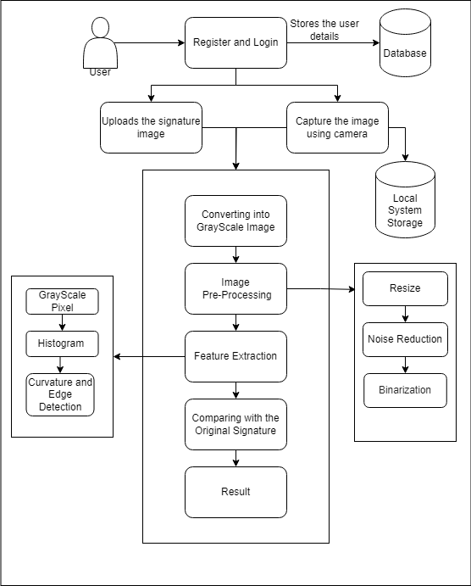
System Architecture Diagram:

Slide 15
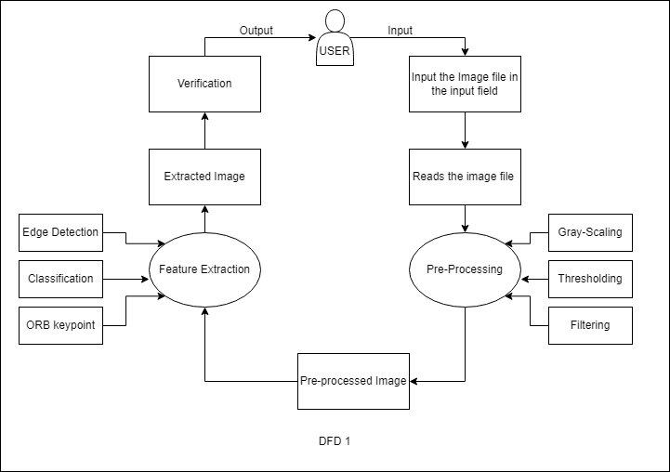
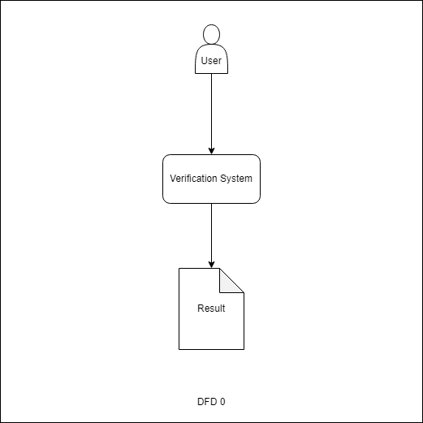
Data Flow Diagram :

Slide 16
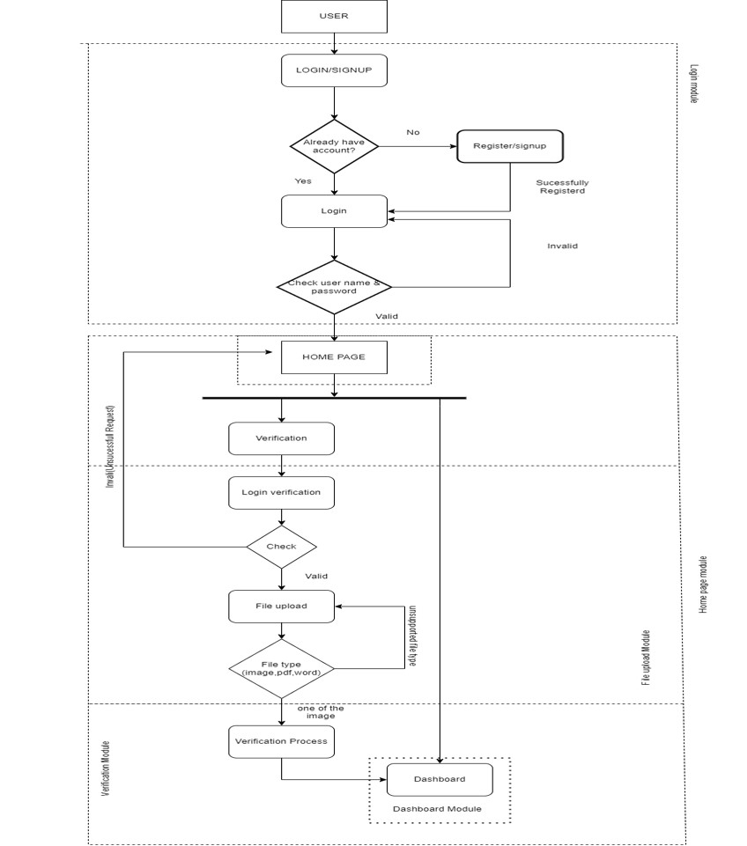
Flow Chart:

Slide 17
Module Description:
Signup Module
Login Module
Home Page Module
Verification Module
Image Pre-Processing
Feature Extraction
Comparison Algorithm

Slide 18
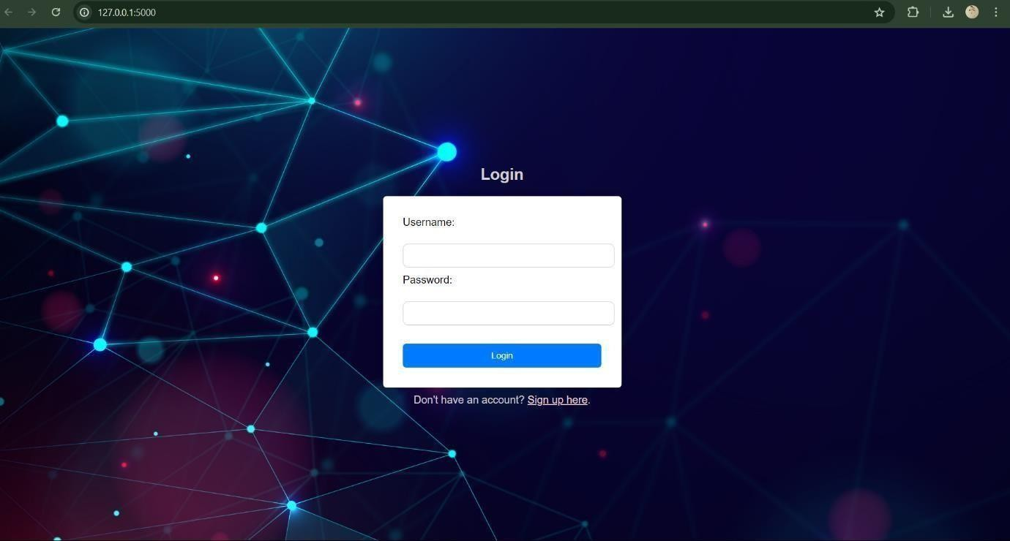
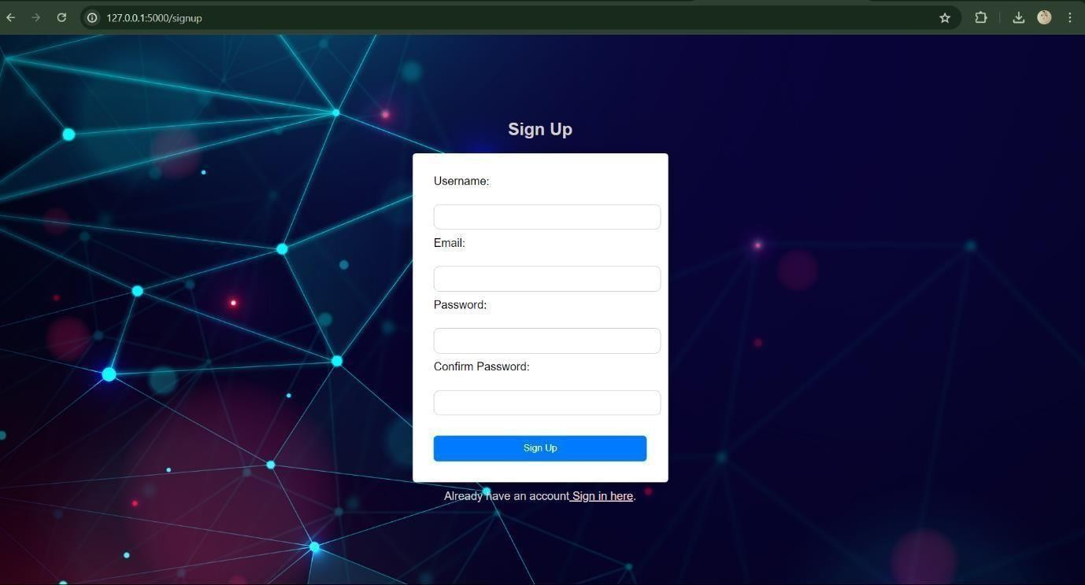
Output:

Slide 19
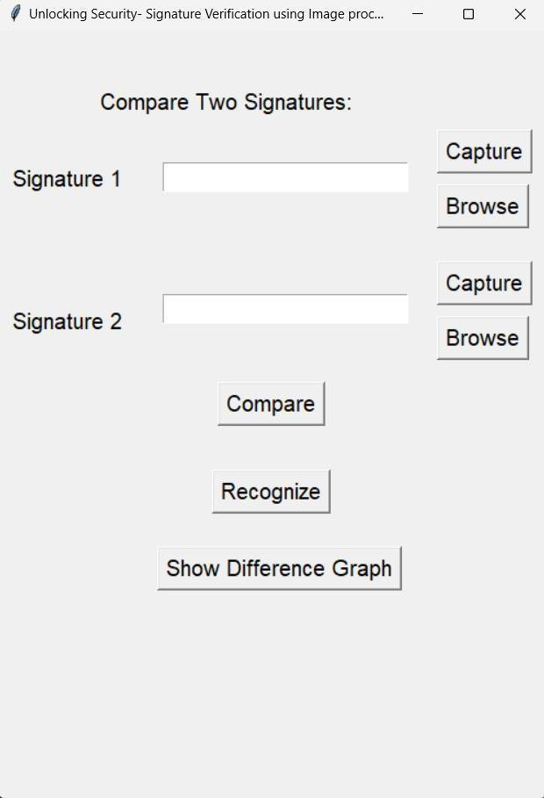
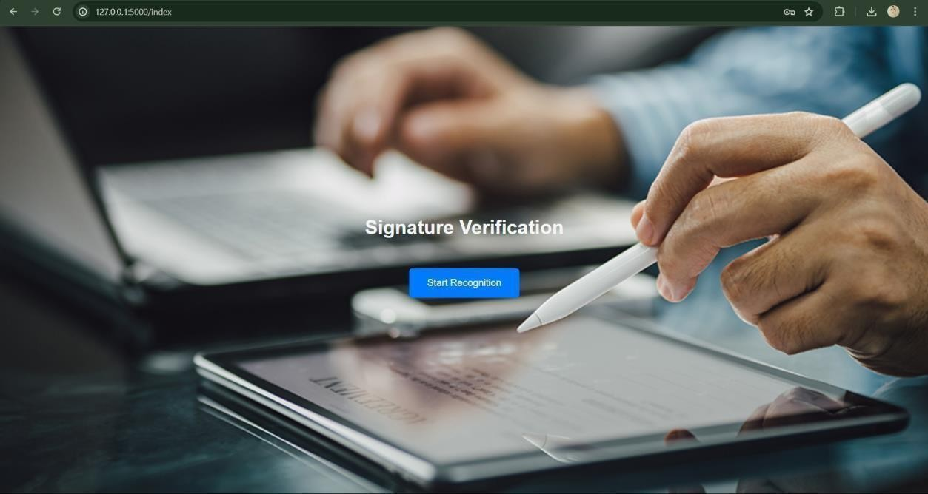

Slide 20
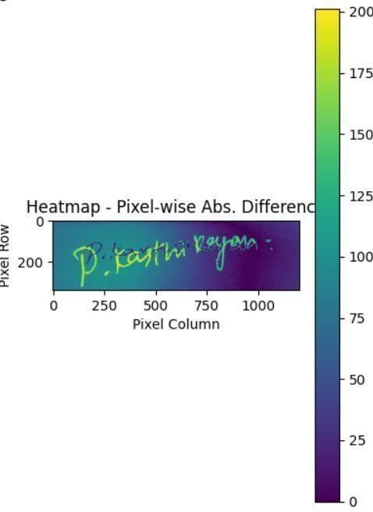
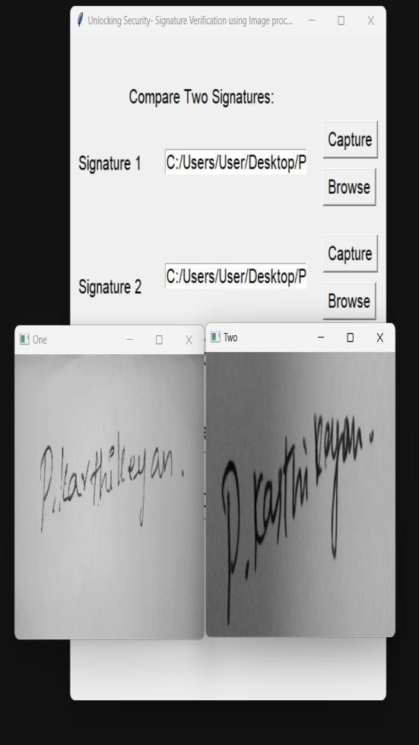
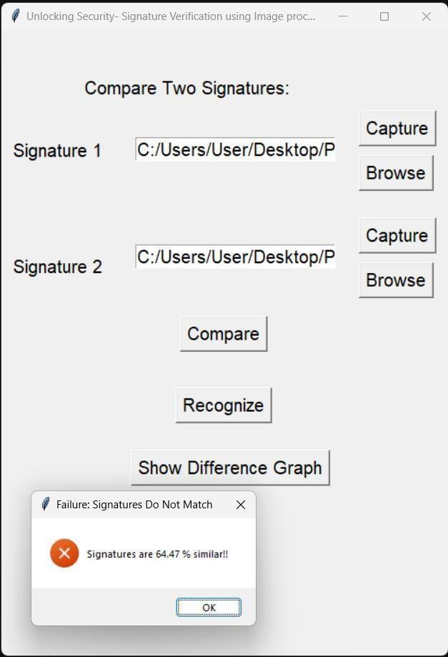
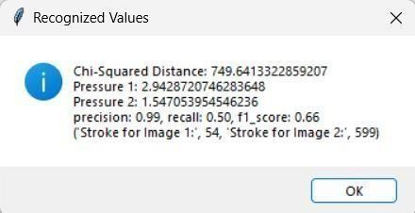
Overall Output:

Slide 21
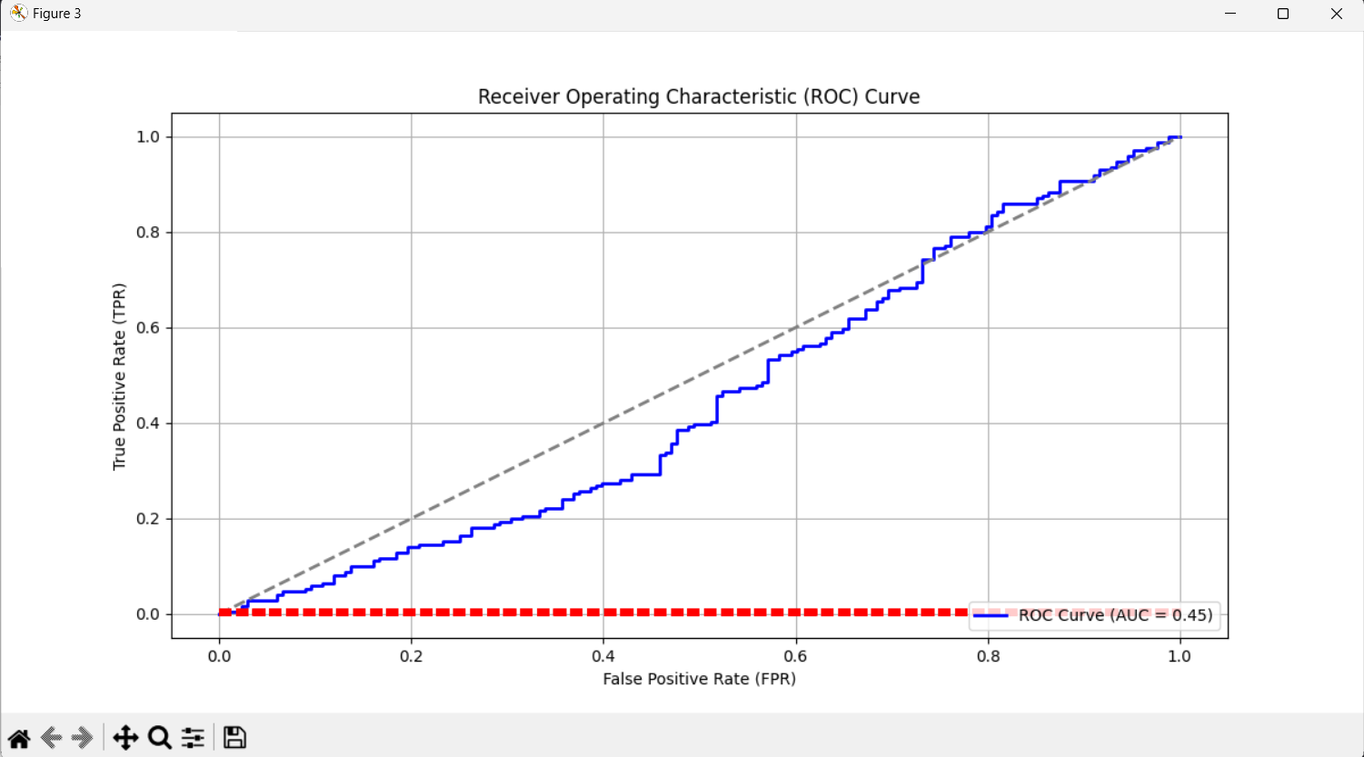
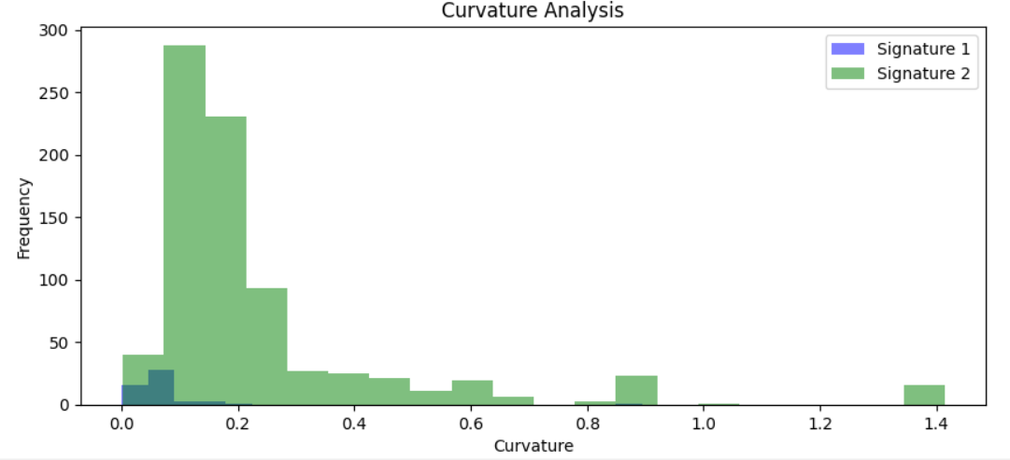

Slide 22
Conclusion:
The signature verification system utilizes image processing to effectively distinguish between genuine and forged signatures.
Through preprocessing steps like normalization, gray scaling, binarizing and noise reduction, input image quality is enhanced, improving the reliability of verification.
Leveraging feature extraction such as edge detection, curvature analysis, grayscale pixel and comparison algorithms such as structural similarity of the image index by dividing the image into the pixel-wise windows or patches, and then it will measure the index similarity.
Its performance metrics, including accuracy and precision, underscore its efficacy across various handwriting styles and conditions. The system's real-time capability enhances its practicality for security-sensitive applications.
However, challenges like signature style variability and susceptibility to skilled forgeries necessitate ongoing refinement. Future enhancements, such as integrating deep learning-based techniques, hold promise for further improving system robustness and accuracy, ultimately advancing identity authentication technology and decides to create and implements the more powerful model for the signature verification system in the future for the more security and safety of our identity.

Slide 23
THANK YOU

